Slide 1

Deepdive Unit Testing in .NET
Day 2

Slide 2
Agenda Day 2
Check-in
Recap
Anti Corruption Layer
Separate Unit & Integration Testing
Test Doubles
Code Coverage vs Test Quality
Legacy
.NET Core
Checkout

Slide 3
Format
Slides
Demos
Hands-On-Labs
TDD katas
Pair programming
Ask for help
Central review afterwards

Slide 4

Anti Corruption Layer

Slide 5
Untestable code due to dependency on external module
Your Module
External Module

Slide 6
Testable code due to Anti Corruption Layer
Your Module
Anti Corruption Layer
Interface
Wrapper
External Module

Slide 7
Dealing with System.IO
Don’t depend directly on System.IO implementation!
Directory.GetFiles(…)
File.Exist(…)
Implement an ACL or use a existing solution such as WrapThat.System and use IDirectory and IFile interfaces in your code.

Slide 8
DEMO: Testing async code

Slide 9
Hands-on-Labs
Perform TDD Kata 6 – Using game state (10 min timebox)
Pair programming
Ask for help
Central review afterwards

Slide 10
Hands-on-Labs
Perform TDD Kata 7 – Saving & loading game state (20 min timebox)
Pair programming
Ask for help
Central review afterwards

Slide 11
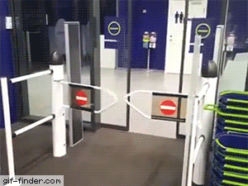
Separate Unit & Integration Testing

Slide 12
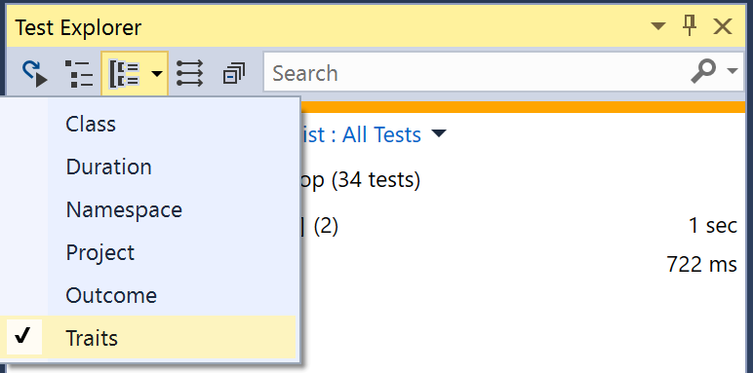
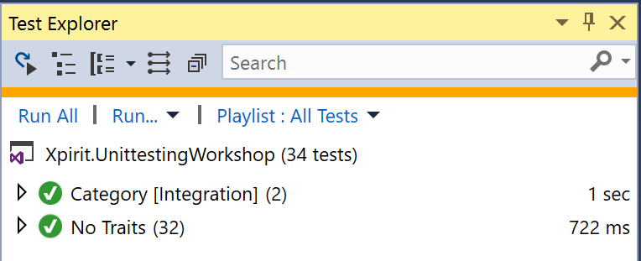
Traits & Categories
[Fact]
[Trait("Category", "Integration")]
public void LoadGameState_FromDisk_ThenGameStateShouldBeLoadedInGameEngine()

Slide 13
Hands-on-Labs
Perform TDD Kata 8 –loading game state from disk (15 min timebox)
Pair programming
Ask for help
Central review afterwards

Slide 14

Test Doubles

Slide 15
Test Doubles
Dummies
Fakes
Stubs
Mocks
https://martinfowler.com/articles/mocksArentStubs.html

Slide 16
Dummies
Objects which are required in SUT but their value is not of importance.
Their state do not influence the outcome of the test.

Slide 17
Fakes
Objects have working implementations, but usually take some shortcut which makes them not suitable for production.

Slide 18
Extract & Override with a Fake
public class GameLogger
{
public void LogError(string message)
{
var fileName = GetLogFileName();
Log(fileName, message);
}
private static string GetLogFileName()
{ ... }
internal virtual void Log(string path, string message)
{
File.WriteAllText(path, message);
}
}

Slide 19
Extract & Override with a Fake
public class FakeGameLogger : GameLogger
{
internal override void Log(string path, string message)
{
// Don't do anything here
}
}
[Fact]
public void TestGameWithLogger()
{
// Arrange
var fakeLogger = new FakeGameLogger();
var gameEngine = new GameEngine(fakeLogger);
...
}

Slide 20
Stubs
Objects to provide canned answers to calls made during the test.
Usually not responding at all to anything outside what's programmed in for the test.

Slide 21
Stub functionality in Moq
// Arrange
var mock = new Mock<IGameEngine>();
mock.Setup(game => game.IsCompleted())
.Returns(true);
mock.Setup(game => game.Start(It.IsAny<IEnumerable<Player>>()))
.Returns(new GameState());

Slide 22
Mocks
Objects pre-programmed with expectations which form a specification of the calls they are expected to receive.

Slide 23
Mock functionality in Moq
// Arrange with loose behavior
var mock = new Mock<IGameEngine>();
// Arrange with strict behavior
var mock = new Mock<IGameEngine>(MockBehavior.Strict);
mock.Setup(game => game.Move(It.IsAny<Player>(), It.IsAny<int>()));
// Assert
mock.Verify(game=> game.Move(It.IsAny<Player>(), It.IsAny<int>()),Times.Once);

Slide 24
AutoFixture
“AutoFixture is an open source library for .NET designed to minimize the 'Arrange' phase of your unit tests in order to maximize maintainability.”
Great for creating test objects (dummies, fakes, stubs).
https://github.com/AutoFixture/AutoFixture

Slide 25
AutoFixture examples
// Arrange
var fixture = new Fixture();
var someString = fixture.Create<string>();
var player = fixture.Create<Player>();
// Create IEnumerable of Player
var players = fixture.CreateMany<Player>();
// Setting one property
var playerWith5Moves = fixture.Build<Player>() .With(p => p.NumberOfMoves, 5)
.Create();
var playerWithOneMove = fixture.Build<Player>()
.Do(p => p.Move())
.Create();

Slide 26
Hands-on-Labs
Perform TDD Kata 9 – Using AutoFixture (20 min timebox)
Pair programming
Ask for help
Central review afterwards

Slide 27

Code Coverage
Vs
Test Quality

Slide 28
Code Coverage
Is:
A metric that shows how much of your code is executed when your tests are run.
A way to visualize what scenarios you might have missed when testing.
Is not:
A metric that shows how good your tests are or what the quality of your software is.
Something to strive for by itself.

Slide 29
Test Quality
Quality of test code should be (near) quality of production code
See day 1 for a list of properties a good unit test has
Tests should be reviewed
Code Coverage should not be the leading metric
https://github.com/riezebosch/tdd-journey/blob/master/slides/20-frustration/8-moooooooahr.md
A better way? Mutation testing!

Slide 30
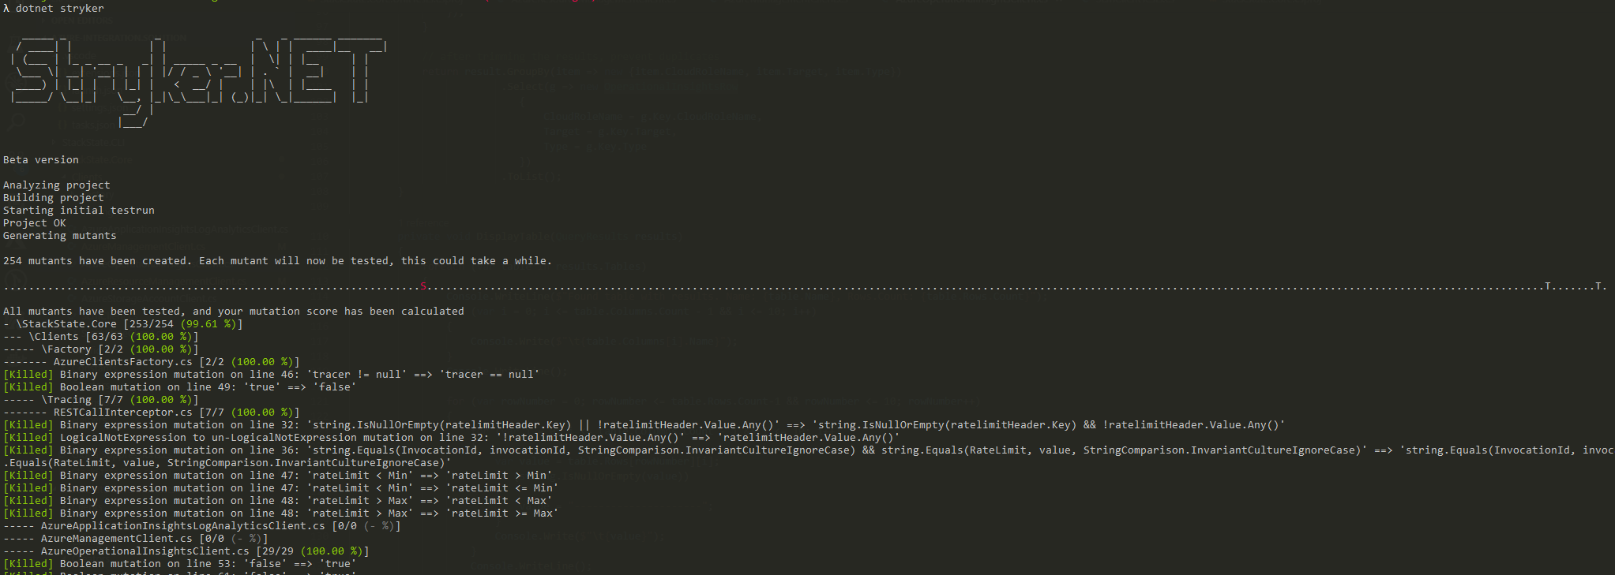
Mutation testing
Stryker: Testing your tests by temporarily inserting bugs
.

Slide 31
Hands-on-Labs
Run Stryker.NET on your TDD Katas code and kill some mutants
https://github.com/stryker-mutator/stryker-net

Slide 32
Stryker – Work in progress
Version 0.4.0 was broken, 0.5.0 was broken, 0.6.0 works, sort of:
Skipping tests based on categories/traits not possible
Feature 'default literal' is not available in C# 7.0. Please use language version 7.1 or greater.
.ConfigureAwait(false) raises lots of “false positives”
Not reliable yet: 99.78% score on a project with really not enough unit tests

Slide 33

Test Strategies

Slide 34

Legacy

Slide 35
Hands-on-Labs
Open UnitTesting\Xpirit.UnittestingLegacy\CCDSchool.sln
Instructions are in HandsOnLab\todo.md

Slide 36
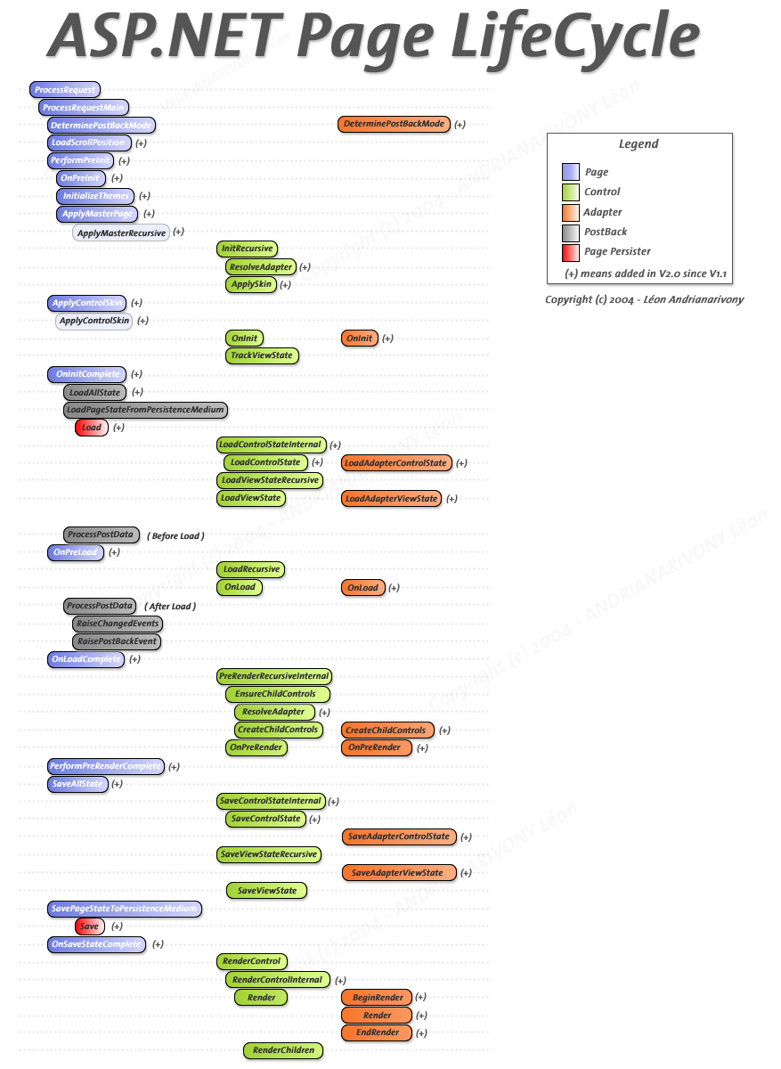
Evaluation
Extract classes
Refactor / rewrite
Manual testing

Slide 37
.NET Core

Slide 38
.NET Core Advantages
Lightweight, faster & cross platform
Possibility for self-contained apps
Some new tools, such as Stryker, only support .NET Core
Rich featureset for modern architectures
Like “TestServer” for integration testing a REST service
Or easy in-memory Entity Framework integration testing
Easy integration with Polly, OpenAPI and more
Extensions, such as “dotnet outdated”
New csproj (also possible with .NET Framework)

Slide 39
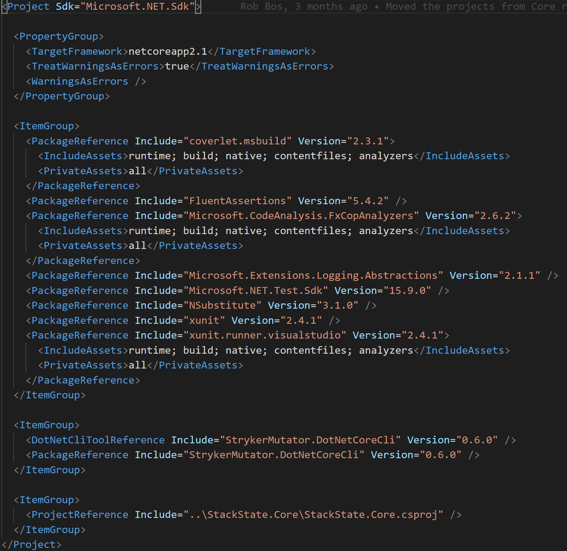
New csproj

Slide 40
.NET Core Disadvantages
Not everything is supported yet (WCF, WPF and more)
Not all libraries support .NET Core (NServiceBus)
Some stuff isn’t as polished as in full framework (code coverage)
Few new things to learn
Migrating takes some effort

Slide 41
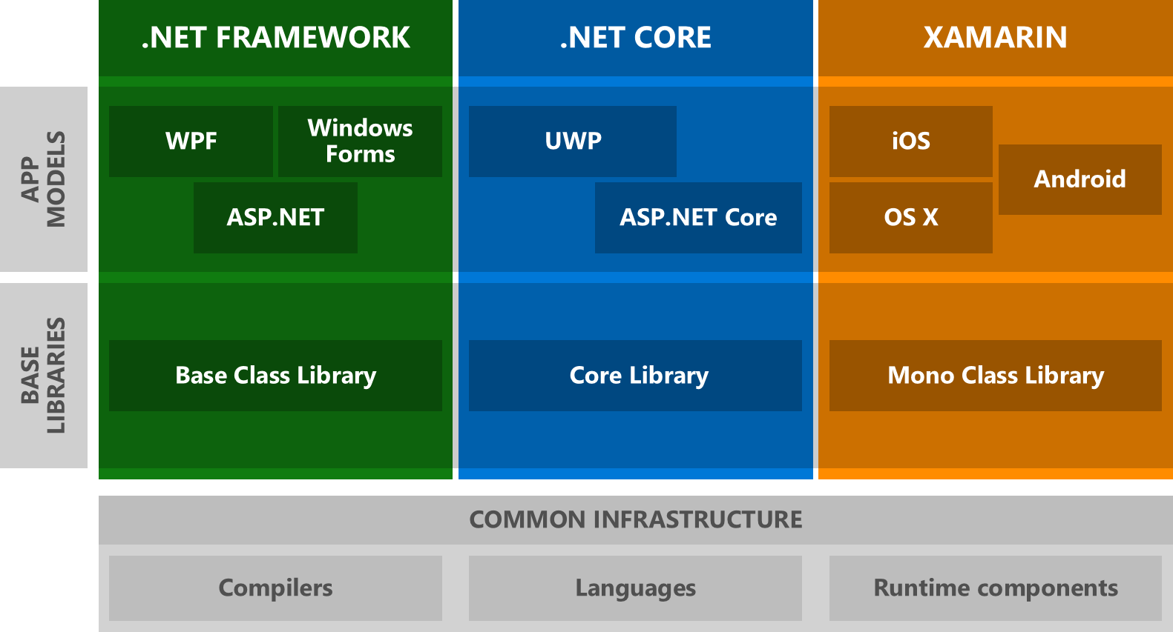
.NET Standard

Slide 42
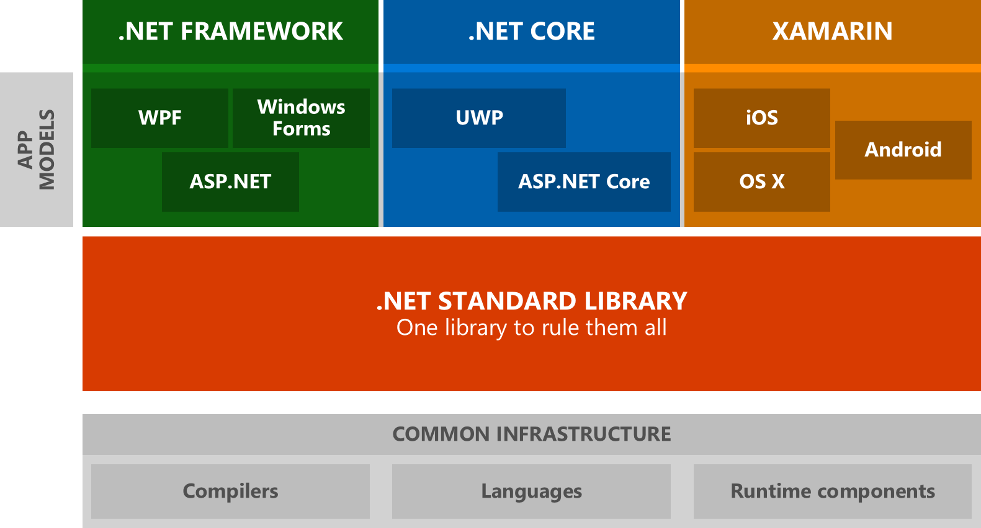
.NET Standard

Slide 43
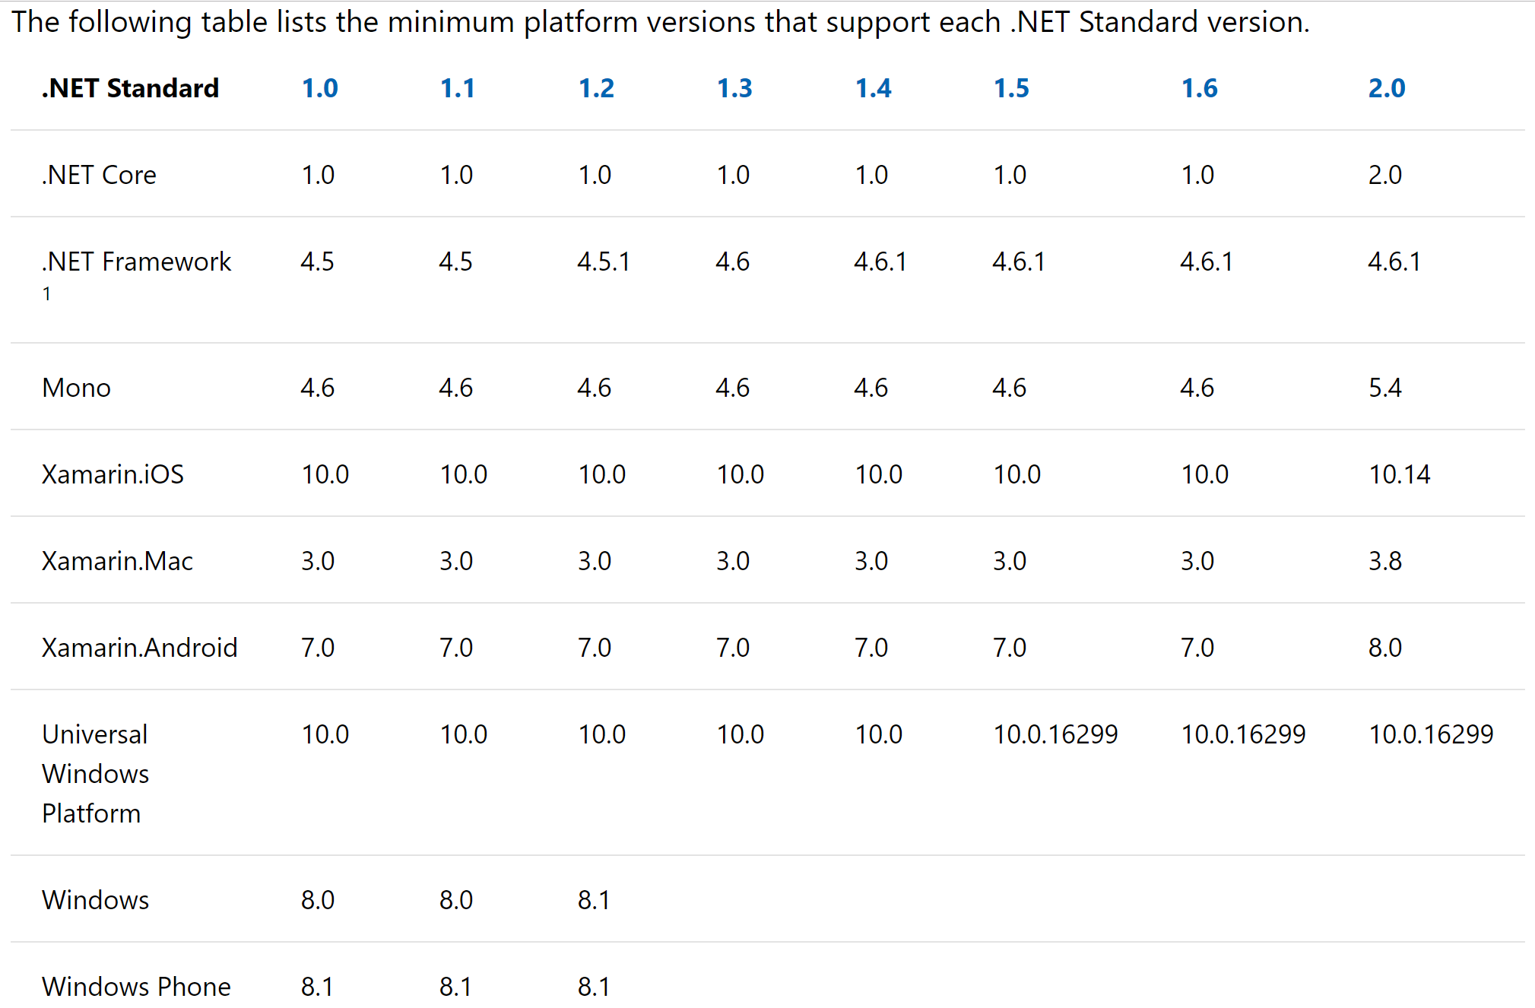
.NET Standard

Slide 44
.NET Core Migration
Manual steps required
Install SDK’s: locally, build servers, target servers
Learn the CLI: dotnet build, dotnet clean, dotnet …
Supporting libraries to .NET Standard first
Redo the .csproj, or create a new project and copy stuff back in
Everything is in .csproj: assemblyinfo, nuspec, nuget packages, etc
Entry-points to .NET Core 2.x last
Update build pipeline if you want
Build csproj instead of solution

Slide 45
.NET Core Experience
Works great in greenfield
Works fine in brownfield, needs some work
Run https://docs.microsoft.com/en-us/dotnet/standard/analyzers/portability-analyzer to get an idea of how much work

Slide 46
Check out
What did you like best?
What could be improved?
Which topics should we cover next lesson?

Slide 47


